Slide 1
PQ2 Polymer Question 2
PE like most polymers has a low thermal conductivity,
k ≈ 0.2 W m⁻¹K⁻¹.
Therefore relying on conventional sensible heat to reach temperature would take a long time for the process. However the high viscosity of the polymer can allow viscous heating (represents transformation of shear forces into heat) to occur.
Calculation A: Calculate the energy to heat 1 cm³ MDPE of density 0.94 g cm⁻³ from 20 to 200˚C assuming a heat capacity of 2365 J kg⁻¹ K⁻¹.
Calculation B: How much energy input is provide by a shear rate of 100 s⁻¹ delivered over 40 s on 1 cm³ of PE ?
(hint: use the figure on previous slide) ?
Notes:
When a viscous fluid in a slit is set in flow by a large imposed pressure gradient, a vast amount of mechanical energy is converted irreversibly into heat owing to the fluid’s internal friction. This viscous heat dissipation not only leads to an overall increase in the fluid’s bulk temperature but also causes a noticeable temperature variation to develop across the shear field.

Slide 2
PQ2 Answer
Answer A:
Quantity of heat Q = c m ΔT = 2365 x 940 x 10⁻⁶ x 180 = 400 J
400 J is required to heat 1 cm³ of MDPE from 20 to 200ºC.
Answer B:
Shear stress (τ) on the top surface of MDPE cube (1cm³) would move it by ϒ in 1 s.
Therefore, the power dissipated by viscous heating per unit volume is P = τ ϒ (wm⁻³)
From shear stress-strain graph, at 100 s⁻¹ the shear stress is 10⁵ Nm⁻²
Energy per unit volume is
E = P t = τ ϒ t = 10⁵ x 100 x 40 = 4 x 10⁸ J m⁻³ = 400 J cm⁻³
Notes:
In this case, strain energy per unit mass = shear stress x shear strain =F/A x dx/L = (F/LxL) x (dx/L) and L = 1, so strain energy per unit volume = F x dx
Power = work done (J)/time
P=F/A=F⋅d/A⋅d=W/V=Energy/V

Slide 3
PQ3 Polymer Question 3
Question: Calculate the volume of methane gas diffusing through a 1 km pipe in a year. Use
where K is the permeability coefficient, A is area of pipe surface, t is the wall thickness and T is time
In your calculation assume a 90 mm OD pipe diameter of wall thickness 8.5 mm and the pressure in the pipe to be 1 bar g (bar gauge), and K for the PE pipe to be 0.075 mm² bar⁻¹ day^{-1.}
Notes:
Absolute pressure = Gauge Pressure + atmospheric pressure (1bar) = 2 bar
Permeability coefficient is the transport flux of material through the material per unit driving force per unit membrane thickness

Slide 4
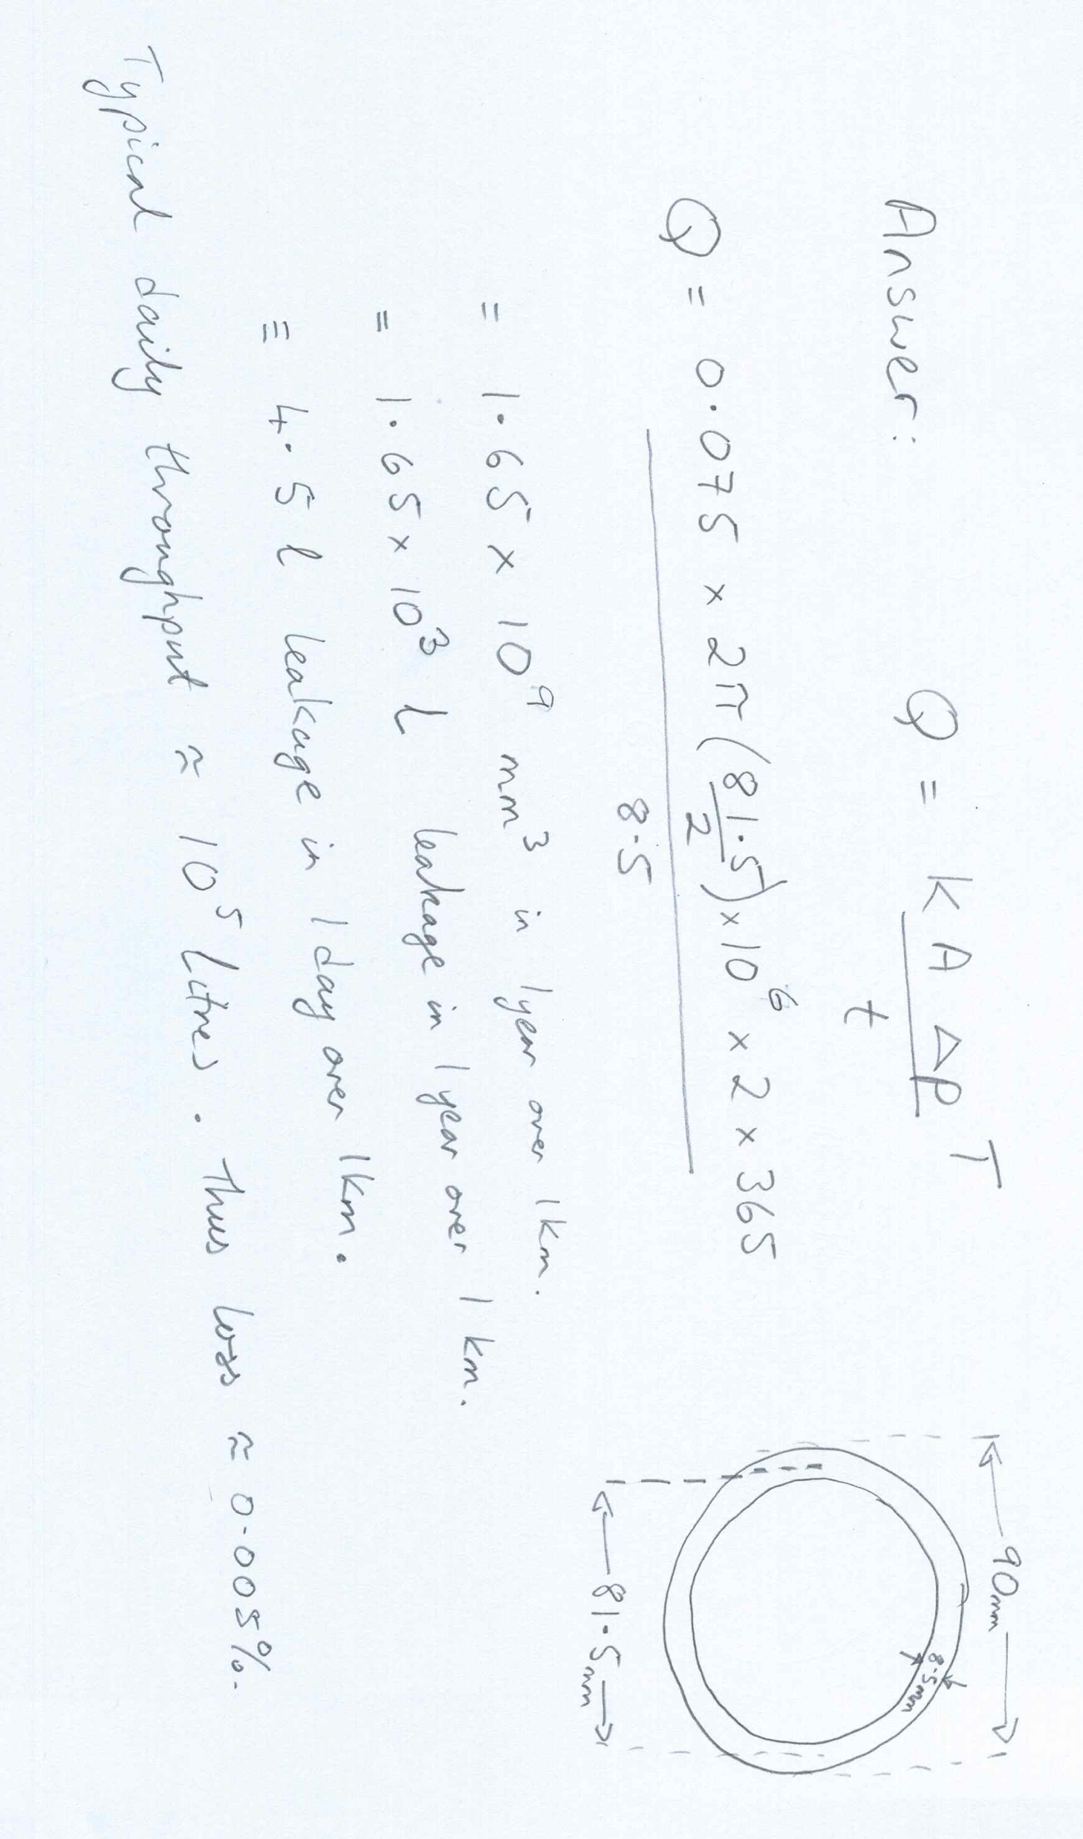
Answer

Slide 5
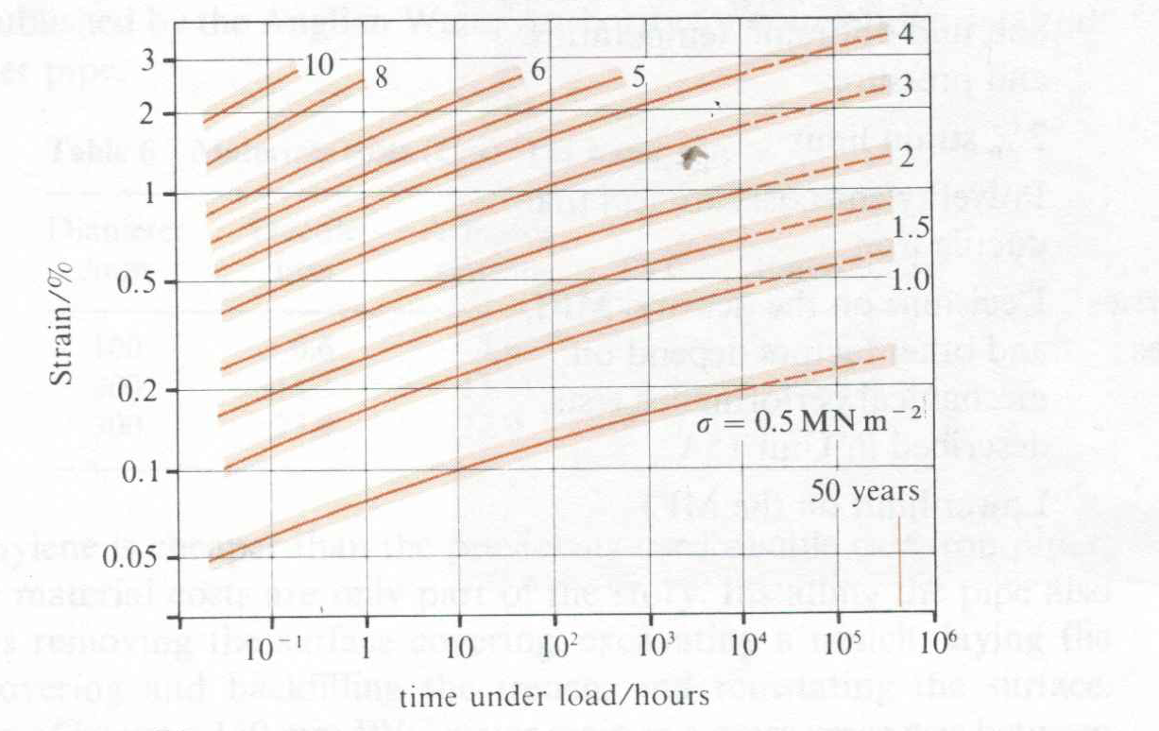
PQ4 Polymer Question 4
Use the equation for creep hoop strain, convert to creep tensile strain and use the graph below to calculate the maximum internal gas pressure in a pipe of R/t =5 with a Poisson ratio of 0.4 to reach 3% hoop strain in 50 years.
Graph: MDPE creep strain /time curves for MDPE test samples under tensile load
Notes:
Non linear after 0.5%
Creep compliemce with time – give an example showing creep complience

Slide 6
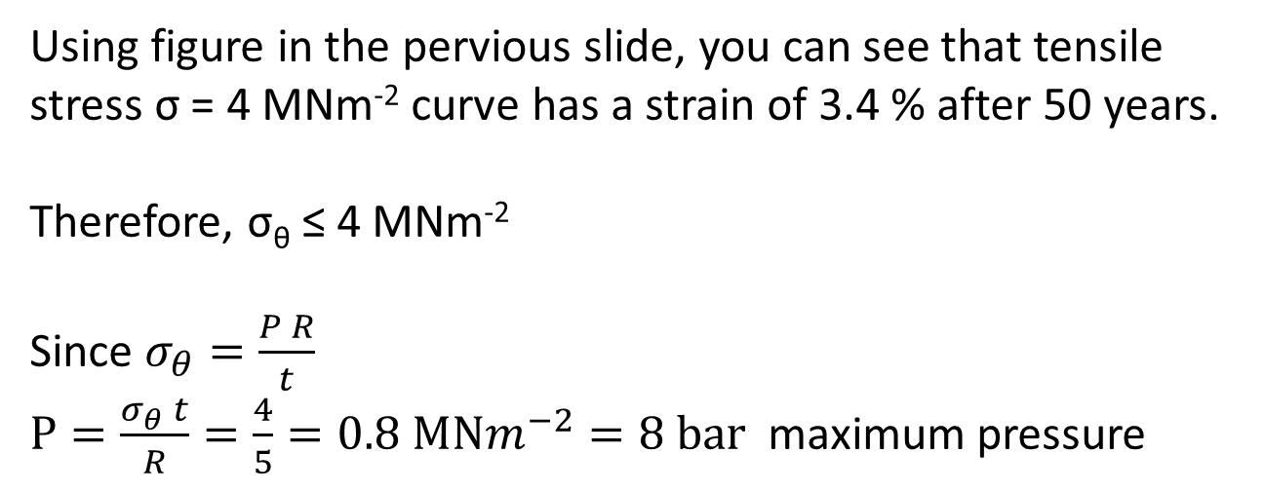
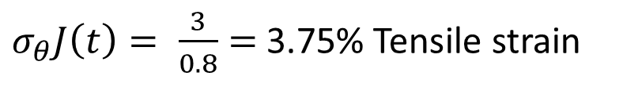

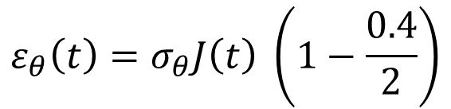
Answer PQ4
$$ε_{θ}\left(t\right)=σ_{θ}J\left(t\right) \left(1−\frac{0.4}{2}\right)$$
$$ε_{θ}\left(t\right)=0.8 σ_{θ}J\left(t\right)$$
$σ_{θ}J\left(t\right)= \frac{3}{0.8}=$3.75% Tensile strain
Using figure in the pervious slide, you can see that tensile stress σ = 4 MNm⁻² curve has a strain of 3.4 % after 50 years.
Therefore, σ_{θ} ≤ 4 MNm⁻²
Since $σ_{θ}=\frac{P R}{t}$
$P=\frac{σ_{θ} t}{R}=\frac{4}{5}=0.8 MNm^{−2}=8 bar$ maximum pressure

Slide 7
PQ9 Polymer Question 9
Under the ground, low gas distribution pipes need to last for 50 years. To avoid gas leakage, we need to carefully measure the allowable gas pressure in the pipe. If the strain of material that creeps under hoop strain is 2.4%, using the graph in Figure Q1 (c), estimate the maximum internal gas pressure in a pipe of with radius (R ) is 10 cm and thickness (t) is 2 cm, with a Poisson ratio of 0.4.

Slide 8
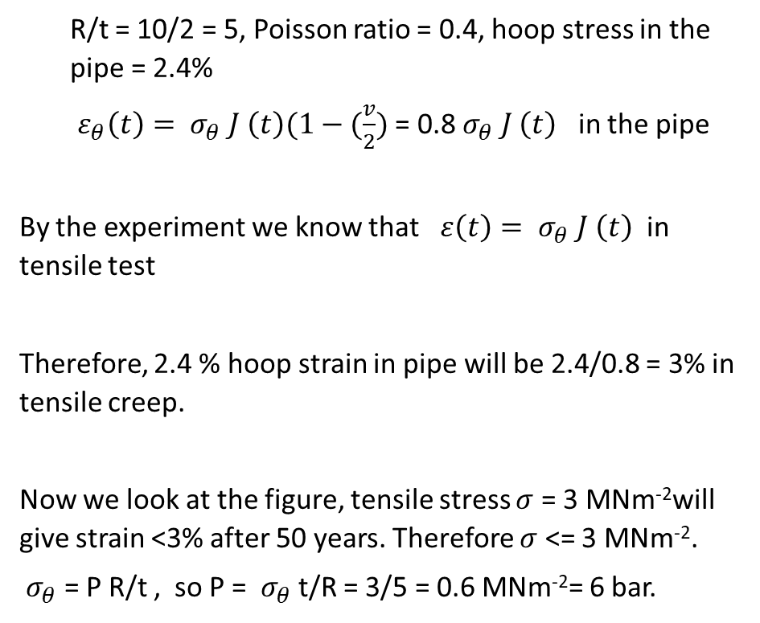
PQ9 Polymer Question 9
Answer
R/t = 10/2 = 5, Poisson ratio = 0.4, hoop stress in the pipe = 2.4%
$ε_{θ}\left(t\right)={ σ}_{θ} J \left(t\right)(1−(\frac{v}{2})$ = 0.8 $σ_{θ} J \left(t\right)$ in the pipe
By the experiment we know that $ε\left(t\right)={ σ}_{θ} J \left(t\right)$ in tensile test
Therefore, 2.4 % hoop strain in pipe will be 2.4/0.8 = 3% in tensile creep.
Now we look at the figure, tensile stress $σ$ = 3 MNm⁻²will give strain <3% after 50 years. Therefore $σ$ <= 3 MNm⁻².
${ σ}_{θ}$ = P R/t , so P = ${ σ}_{θ}$ t/R = 3/5 = 0.6 MNm⁻²= 6 bar.

Slide 9
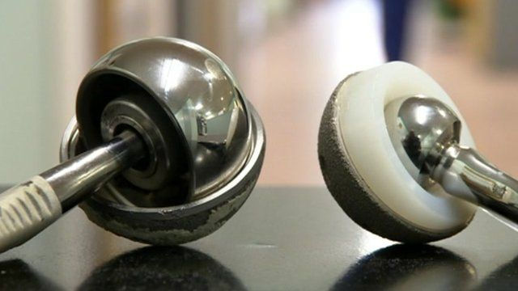
Acetabular cup- hip replacement
Function: Acetabular cup for hip replacement
Objective: delivering low wear rate
Constraints: must be physically and mechanically stable under physiological conditions, able to sterilised, does not leach-out harmful materials….
Free variable: choice of material.
Notes:
They analysed the National Joint Registry of England and Wales for primary hip replacements (402 051 cases, of which 31 171 were stemmed metal-on-metal) undertaken between 2003 and 2011. “Experts are calling for controversial metal-on-metal hip implants to be banned in 2012.

Slide 10
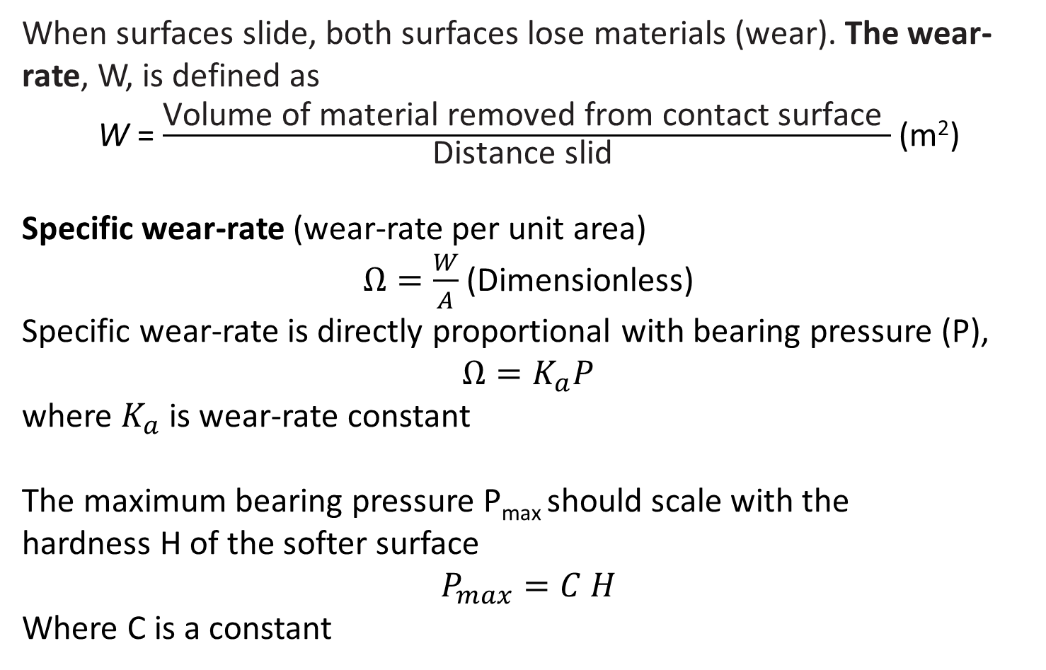
Low Wear rate materials
When surfaces slide, both surfaces lose materials (wear). The wear-rate, W, is defined as
W = $\frac{\text{Volume} \text{of} \text{material} \text{removed} \text{from} \text{contact} \text{surface} }{\text{Distance} \text{slid} }$ (m²)
Specific wear-rate (wear-rate per unit area)
$Ω=\frac{W}{A}$ (Dimensionless)
Specific wear-rate is directly proportional with bearing pressure (P),
$Ω=K_{a}P$
where $K_{a}$ is wear-rate constant
The maximum bearing pressure P_{max} should scale with the
hardness H of the softer surface
$$P_{max}=C H$$
Where C is a constant

Slide 11
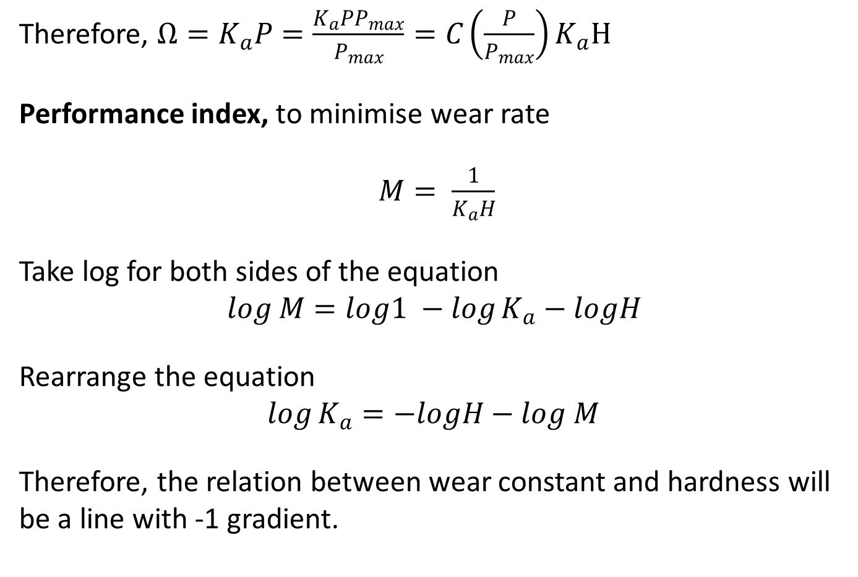
Low Wear rate materials
Therefore, $Ω=K_{a}P=\frac{K_{a}PP_{max}}{P_{max}}=C\left(\frac{P}{P_{max}}\right)K_{a}H$
Performance index, to minimise wear rate
$M= \frac{1}{K_{a}H}$
Take log for both sides of the equation
$$log M=log1 −\log{K_{a}}−logH$$
Rearrange the equation
$$\log{K_{a}}=−logH−log M$$
Therefore, the relation between wear constant and hardness will be a line with -1 gradient.

Slide 12
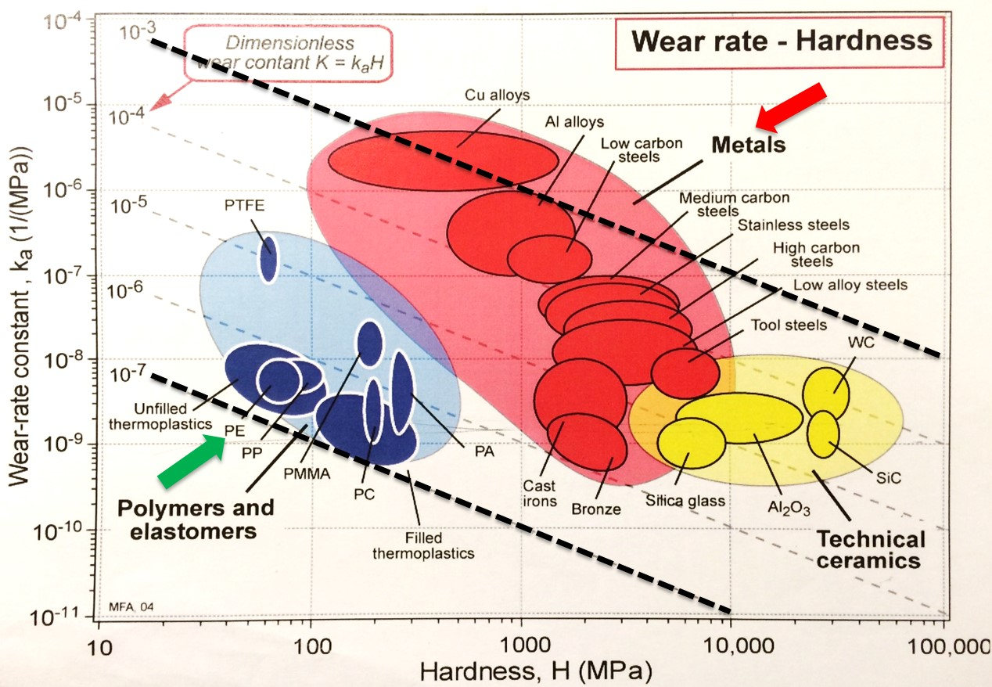
Wear rate – Material selection
Wear rate for metals is 4 orders of magnitude higher than PE

Slide 13
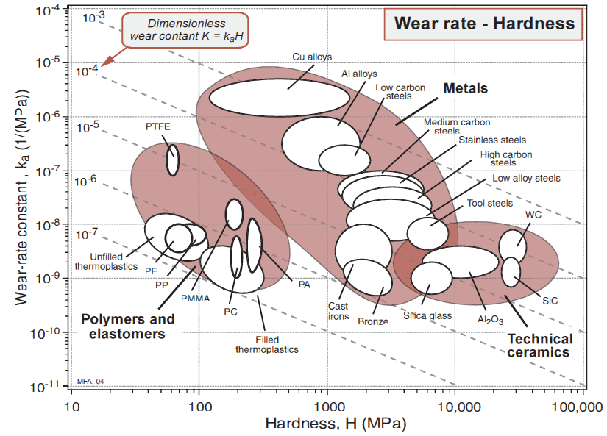
Wear rate – Question
Which polymer has the highest wear performance (i.e. lowest wear rate) and hardness greater than 100 MPa?

Slide 14
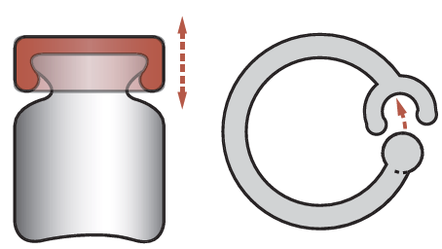
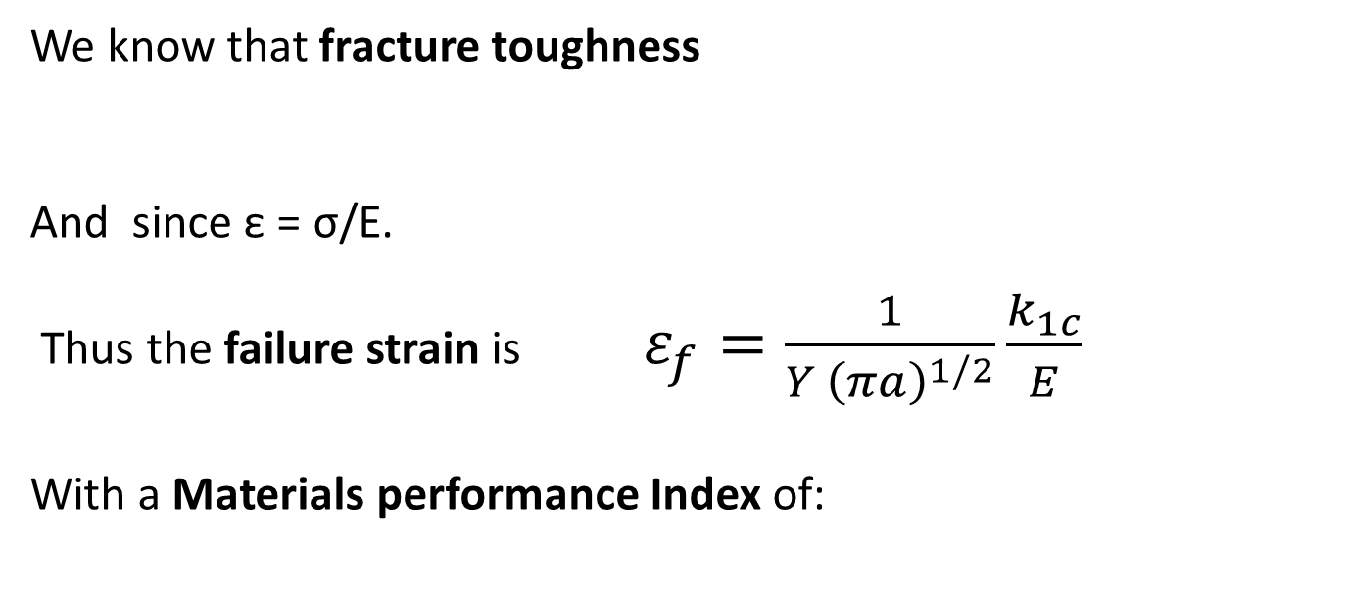
Deflection Limited Design: Snap clips/lids
Function: Resist brittle failure
Objectives: Secure fitting or lid
Constraints: Deflection specified by design
at low cost
Free variable: Choice of material
We know that fracture toughness
And since ε = σ/E.
Thus the failure strain is $ε_{f}=\frac{1}{Y {\left(πa\right)}^{1/2}}\frac{k_{1c}}{E}$
With a Materials performance Index of:

Slide 15
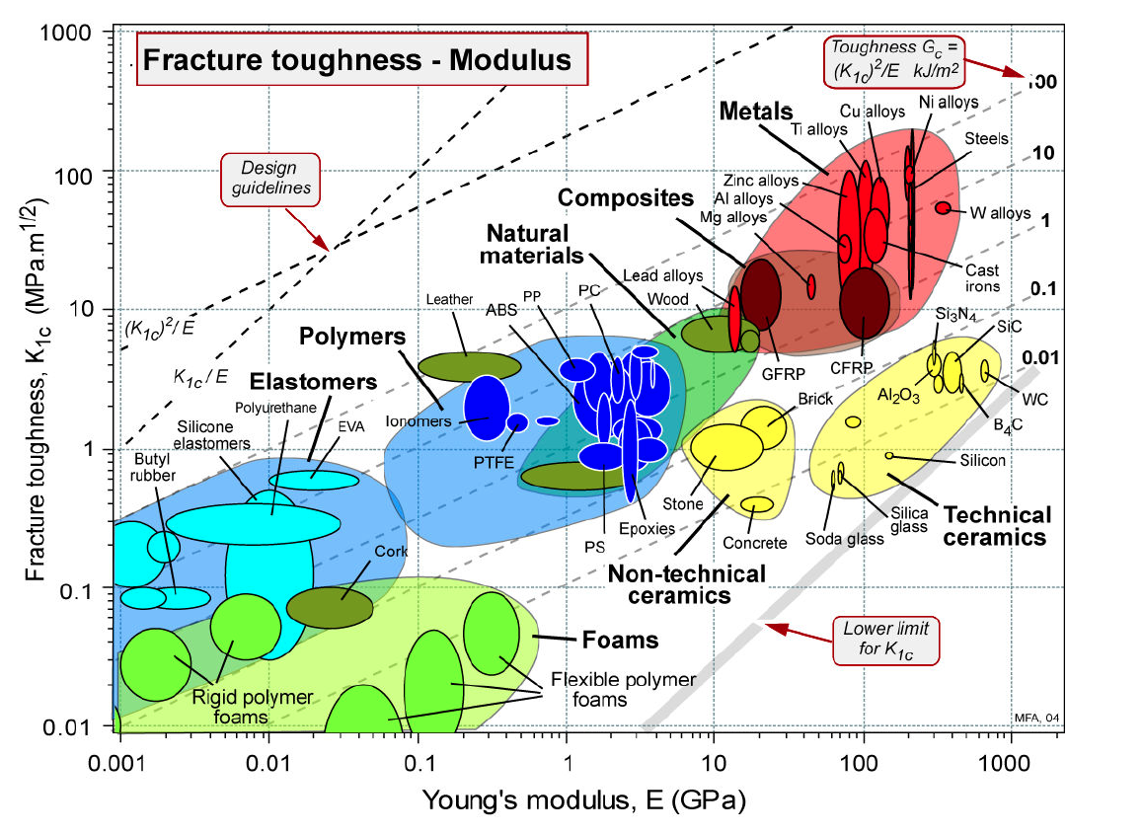

Slide 16
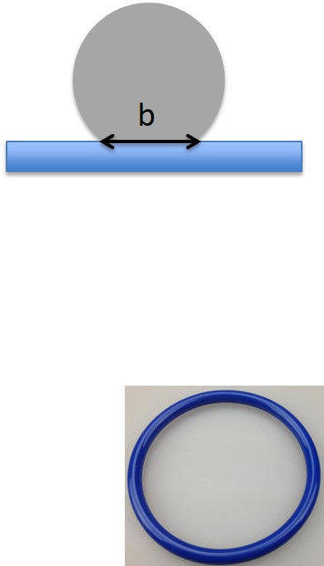
Elastic Seals
Function: Provide a tight elastic seal
Objectives: maximum conformity to surface
Constraints: limit on contact pressure required, low cost
Free variable: Choice of material
A materials in the shape of a cylinder of radius R and modulus E pressed into a flat surface will create a flat contact width, b, which is related the yield (or failure) stress and elastic modulus as follows*:
Thus contact width is maximised with a Materials Index of:
Make your selection from the following chart
*Proof on p155, section 6.9 of “Materials Selection in Mechanical Design, 4th Edition by M. F. Ashby

Slide 18
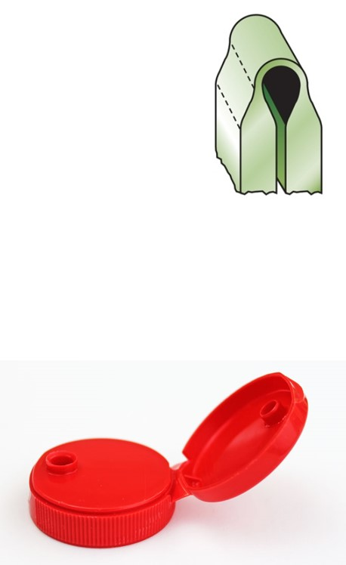
Elastic Hinges
Function: Recoverable elastic hinge
Objectives: Maximum elasticity without failure, i.e. minimum radius
Constraints: Must not fail
Free variable: Choice of material
The surface strain of hinge of thickness, t, and radius R is:
Thus maximum stress is:
Radius must be:
Want minimum radius so the Materials
Performance Index is related to 1/R so:
Notes:
Comment on how certain design requirements may have similar Materials indexes

Slide 20
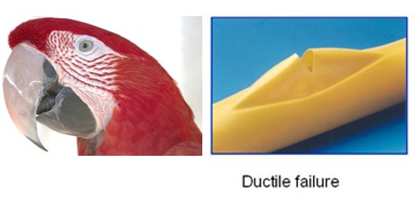
PQ10 Polymer Question 10
Why shape and direction of the ductile creep rupture showed a “parrot beak” shape?
Answer
“Parrot beak” shape is follow the hoop/circumferential stress direction, therefore the pipe is failed producing the characteristic of parrot beak fracture.

Slide 21
PQ6 Polymer Question 6
As can be seen from material selection chart, there are many options for a low pressure gas pipe based on your performance index. Comment on why the final selection is based on PE by considering other selection criteria for the other polymeric, metallic and ceramic materials.
Answer
The ceramics are below the line having very low a toughness. The metals need expensive fittings or costly joining techniques. Metals have also low chemical stability. Polymers of which the most commonly used is PE offer a suitable choice for a large low pressure gas distribution network as it is a low temperature thermoplastic and thus can be welded easily.

Slide 22
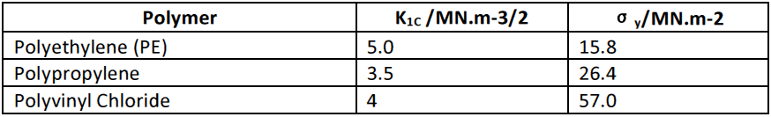

PQ7 Polymer Question 7
A “Yield before break” or ductility factor is used as material performance index to prevent plain strain fracture in polymer. Using a suitable equation derive a yield before break performance index and use this Table, to rank these polymers.
Answer
The highest is PE followed by PP and then PVC
PE PP PVC
Polymer | K1C | σy | Ductility factor
PE | 5.0 | 15.8 | 31.9 mm
PP | 3.5 | 16.4 | 14.5 mm
PVC | 4 | 54.0 | 1.7 mm
$$a_{c}=\frac{1}{π}{\left(\frac{K_{Ic}}{σ_{y}}\right)}^{2}$$

Slide 23
PQ8 Polymer Question 8
Extrusion is an example of an important processing method for
polymers. Explain how the screw speed influence the effectiveness of the extrusion process.
Answer
If screw speed too fast - insufficient residence time to melt the polymer, can lead to melt fracture as a result of instability due to slip of the melt at the die walls. This leads to roughened surfaces, “sharkskin surfaces”
If screw speed too slow - excessive temperatures through viscous heating will degrade the polymer by oxidation.
$$a_{c}=\frac{1}{π}{\left(\frac{K_{Ic}}{σ_{y}}\right)}^{2}$$

